Slide 1
Capstone Project -3
Appliance Energy Prediction By:- Rohit Kumar Sharma

Slide 2

Let’s Catch The Defaulters
Defining problem statement
EDA and feature engineering
Feature Selection
Preparing dataset for modelling
Applying Model
Model Validation and Selection

Slide 3

Defining Problem Statement
In this time of global uncertainty world needs energy and in increasing quantities to support economic and social progress and build a better quality of life, in particular in developing countries. But even in today’s time there are many places especially in developing world where there are outages.
These outages are primary because of excess load consumed by appliances at home. Heating and cooling appliances takes most power in house. In this project we will be analyzing the appliance usage in the house gathered via home sensors. All readings are taken at 10 mins intervals for 4.5 months . The goal is to predict energy consumption by appliances .
In the age of smart homes, ability to predict energy consumption can not only save money for end user but can also help in generating money for user by giving excess energy back to Grid (in case of solar panels usage). In this case regression analysis will be used to predict Appliance energy usage based on data collected from various sensors.

Slide 4
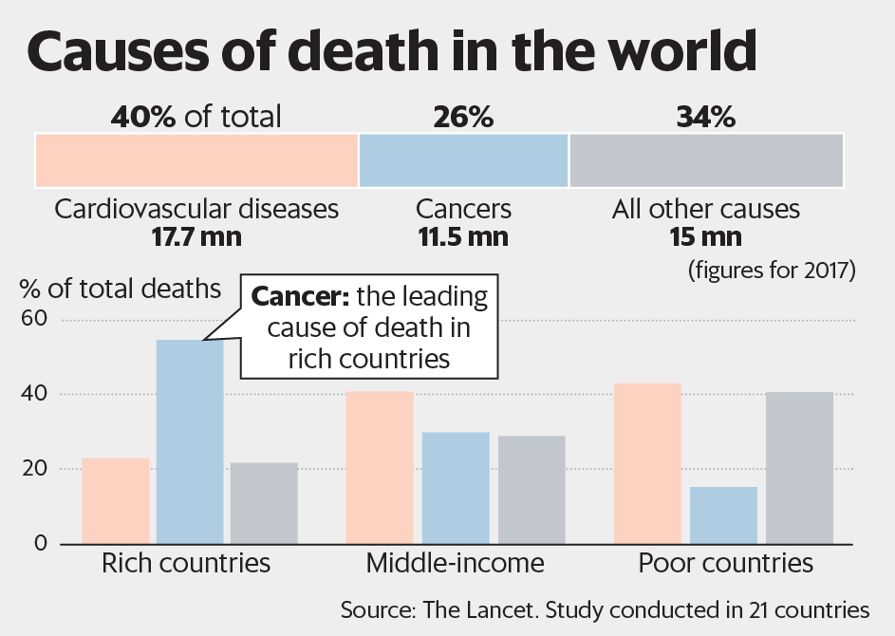

Slide 5
Data Pipeline
Data processing- 1 : In this first part we’ve removed unnecessary features. Since there were nearly many columns with all null values.
Data processing-2 : In this part, we have encoded the categorical features and rename the columns as required.
EDA : In this part, we will handle missing values and see the distribution of data. We also compare categorical variable.
Feature Selection: In this part we will try to capture all the important, interesting features in a data set with respect to an outcome variable.
Models and Prediction: In this part we will split our data and do some feature scaling, after that we will train our model. At last we will compare our model to get an outstanding model.

Slide 6
Data summary
BP Meds : It tells whether or not the patient was on blood pressure medication.
Prevalent Stroke: whether or not the patient had previously had a stroke.
Prevalent Hyp: whether or not the patient was hypertensive
Diabetes: whether or not the patient had diabetes
Tot Chol: total cholesterol level
Sys BP : systolic blood pressure
Heart Rate: heart rate (Continuous - In medical research, variables such as heart rate though in fact discrete, yet are considered continuous because of large number of possible values.)
CHD: It tells how many people are suffering from coronary heart disease.

Slide 7
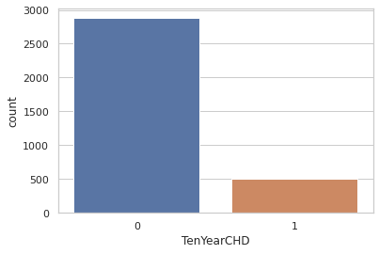
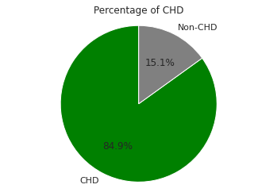
Define Dependent Variable
There are 2879 patients without heart disease and 511 patients with the disease.

Slide 8
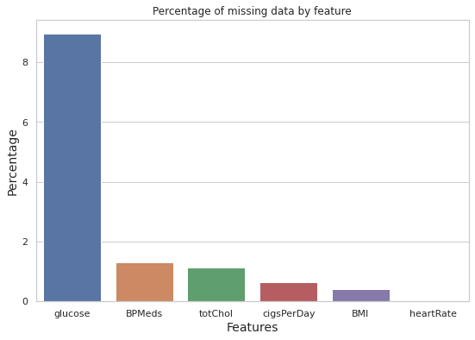
EDA

Slide 9
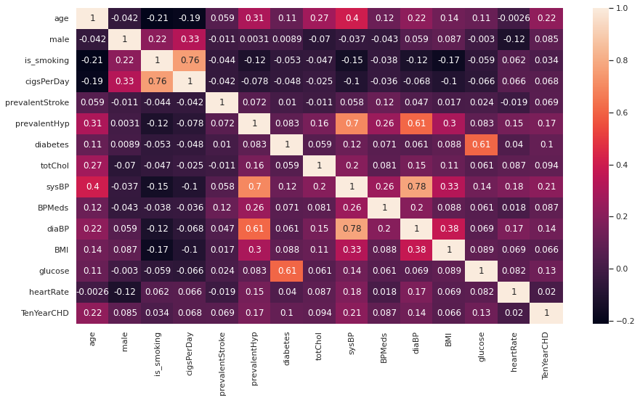
EDA

Slide 10
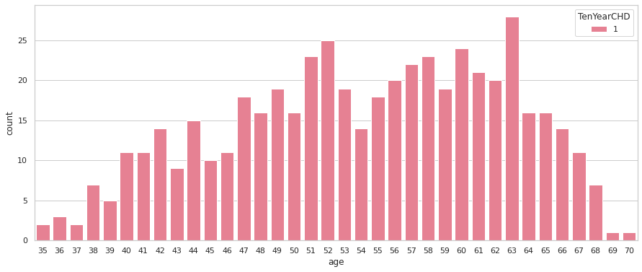
EDA

Slide 11
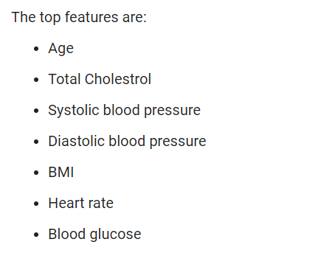
Feature Selection
By applying Boruta algorithm we get top features :-

Slide 12
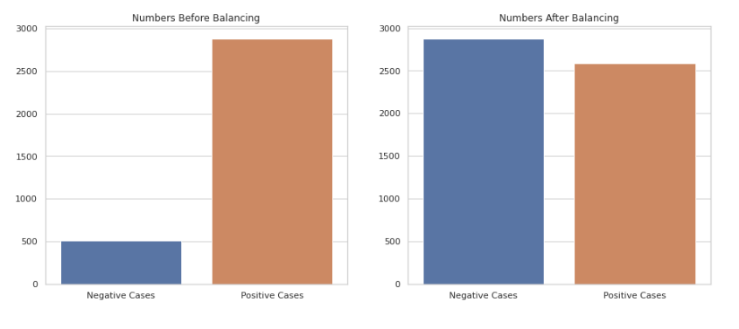
Oversampling (SMOTE)

Slide 13
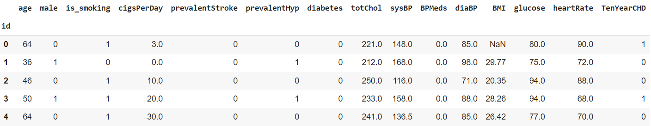
Preparing Dataset for modelling
Task :- Binary classification
Train set:- (2712,15)
Test set :- (678,15)
Response:- 0/1

Slide 14
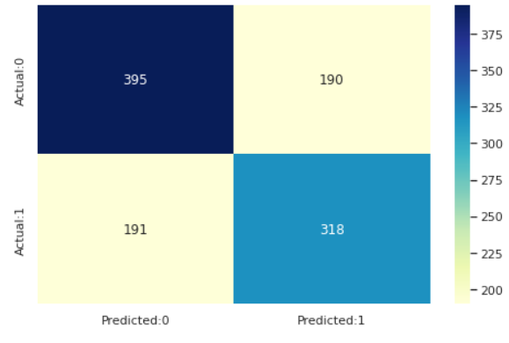
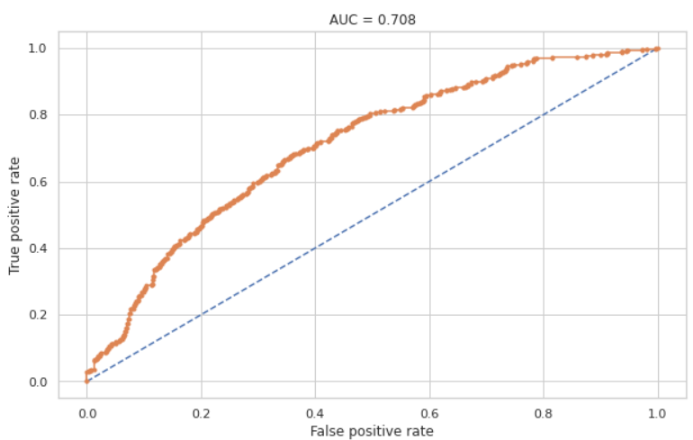
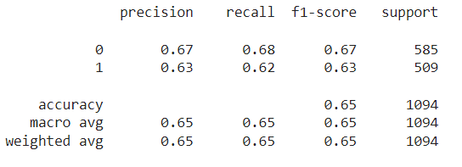
Applying Model – Logistic Regression

Slide 15
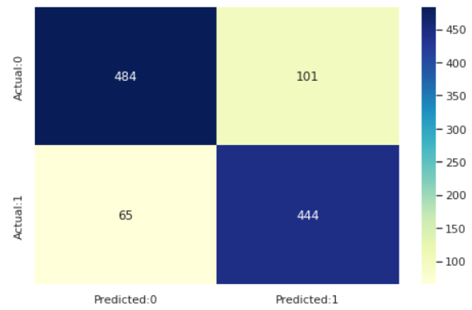
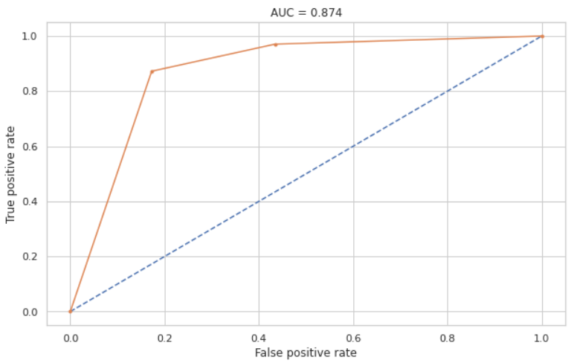
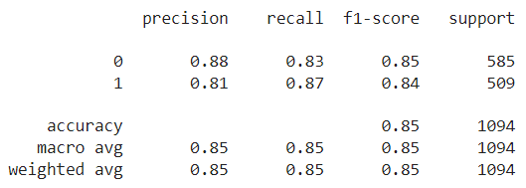
Applying Model – K nearest Neighbour

Slide 16
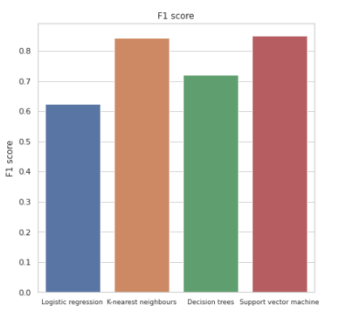
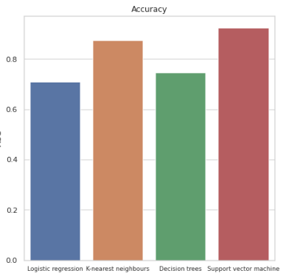
Model Validation & Selection

Slide 17
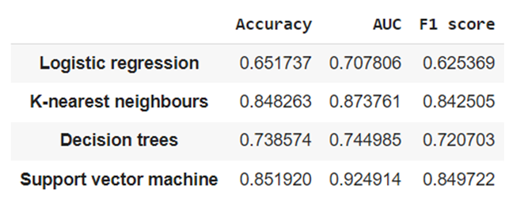
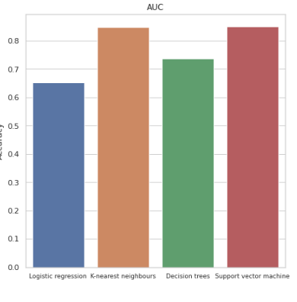
Model Validation & Selection

Slide 18

Model Validation & Selection
Observation 1: As seen in the above table, Logistic Regression is not giving great results, Decision Trees are had bit better than Logistic Regression.
Observation 2: K nearest neighbour is giving best result than decision tress in terms of accuracy and F1 score, but support vector machine is better than all three model.

Slide 19

Model Validation & Selection(continued)
Observation 3: From the above observation we have come to the conclusion that we would choose support vector machine model.
Cross validation accuracy for SVM model is 84.93%.

Slide 20
Conclusion
The most important features in predicting the ten year risk of developing CHD were age and systolic blood pressure
The Support vector machine with the radial kernel was the best performing model in terms of accuracy and the F1 score. Its high AUC shows that it has a high true positive rate.
Balancing the dataset by using the SMOTE technique helped in improving the models' sensitivity, this is when compared to the performance metrics of other models on different notebooks on the same dataset
With more data(especially that of the minority class) better models can be built

Slide 21
Challenges
Huge chunk of data was to be handled keeping in mind to miss anything which is even of little relevance.
Feature selection was quite a challenge as our dataset had many features that were independent of each other.
Computation time (especially SVM and cross validation)
Dataset was imbalanced.

Slide 22
Thank You

